Slide 1

Housing Presentation
City of Whitewater – City Council
March 4, 2025
Prof. Kurt Paulsen
The opinions expressed herein are my own and do not necessarily represent the opinions of the Board of Regents of the Universities of Wisconsin, the Wisconsin Realtors Association, WHEDA or any city, county, or state agency. Permission is given to all to distribute and freely use the information and graphics presented herein, provided no fee is charged and proper attribution is given. The information presented is from publicly available data sources, but no representation or warranty is offered as to accuracy or timeliness. This presentation is for informational purposes only and does not constitute any tax, legal, or financial advice.

Slide 2
Housing Demand: demographics and income/jobs
Key messages:
Slower than national average growth in jobs, income, and population
Households continue to grow faster than housing units;
- Renter income growth suggests “displaced demand” – people who might otherwise have purchased homes if available/affordable

Slide 3
Housing Demand: demographics and income
Overall, slow rate of household growth = 0.70 percent per year
Growth mostly in 1-person and 2-person households
Average household size has declined
Housing demand for 1- and 2-person households = smaller units, different housing types

Slide 8
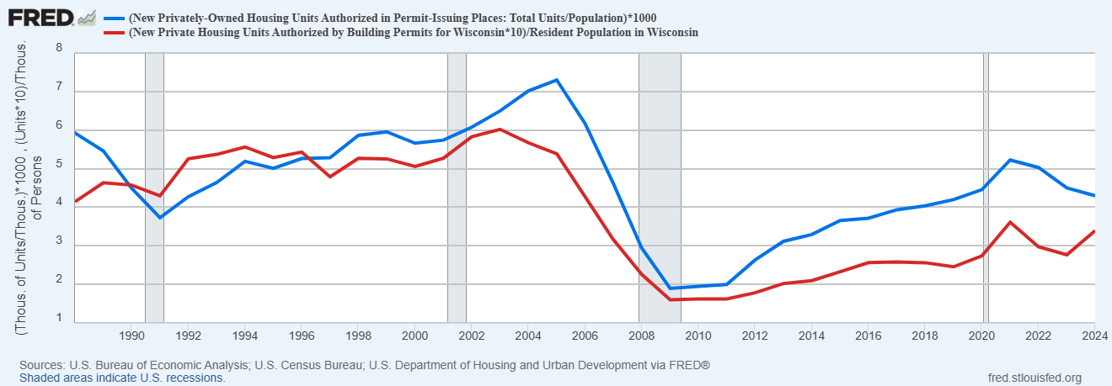
Wisconsin has built fewer housing units per-capita than the US since the late 1990s; gap widened after 2008.

Slide 10
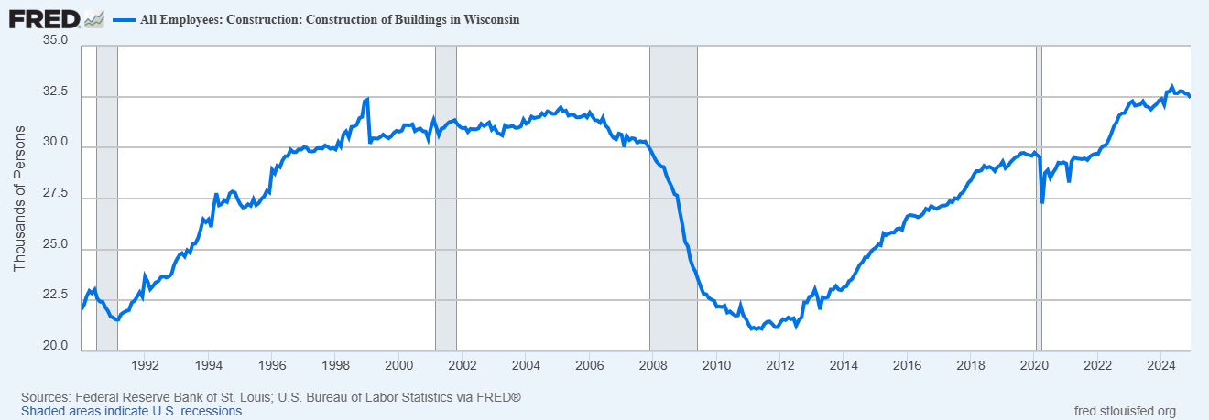
Construction Employment in Wisconsin finally exceeds 2005 peak

Slide 12
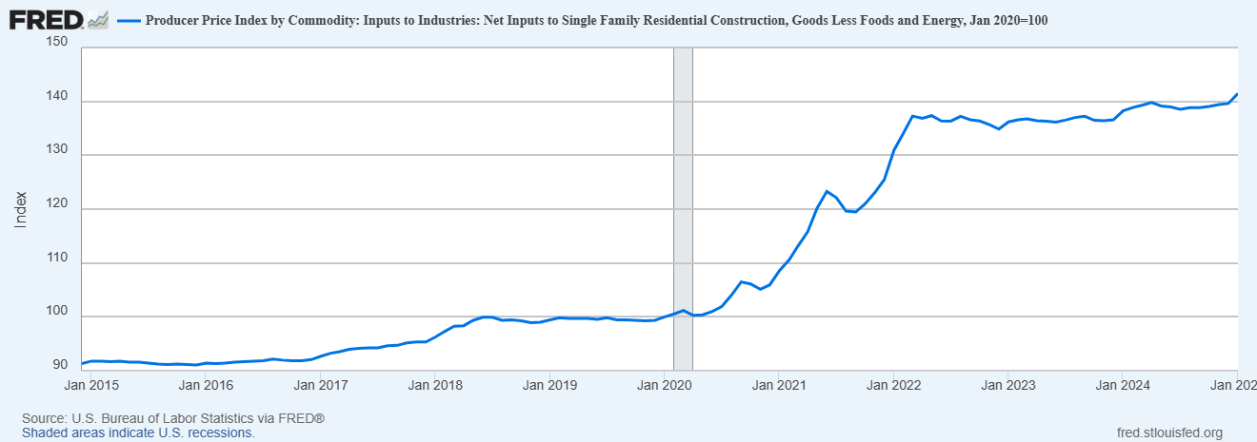
Single-family Construction Costs up 41.5 percent
(Jan. 2020 to Jan. 2025)

Slide 13
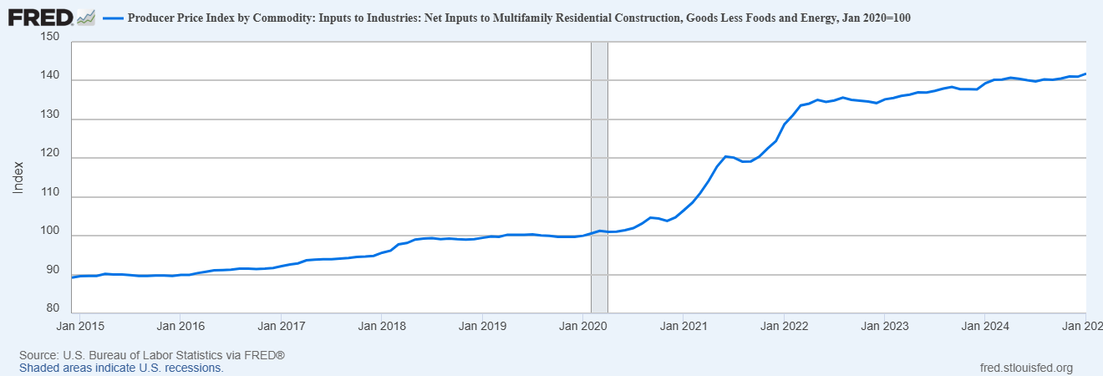
Multifamily Construction Costs Up 41.8 percent
(Jan. 2020- Jan. 2025)

Slide 14
Housing Affordability Declined in Every Wisconsin Region

Slide 18
TIF and Multifamily Housing
Concept of “Break Even Rents” – The rents a property provider would need to be able to charge to cover debt service, operating costs (including reserves), and normal market investor returns.
Or, think of it as: land costs + hard costs + finance costs +soft costs + investor return.
The “Elasticity of Break Even Rent” relative to construction costs is about 1. (Actually 1.02, but close enough to 1). Source: Ericksen, M. and Orlando, A. 2024. A cost decomposition of break-even rents for new multifamily development. Journal of Housing Economics 66 (2024) 102012.
In English: For every 1-percent increase in construction costs, there is a 1-percent increase in the break-even rents. Construction costs have skyrocketed.
In markets like Dane County/Madison where “break-even rents” are above or near current market rents, new market-rate multifamily housing can be constructed without the need for financial incentives.
In markets like Whitewater where “break-even rents” are way above current market rents, new multifamily housing cannot be constructed without the need for financial incentives.

Slide 19
TIF and Multifamily Housing
I examined the most recent proposed low-rise, wood-frame multifamily construction in Whitewater based on summary sheet from Ehlers. Total cost per unit is $249k. Break down is hard costs (always the biggest portion of any multifamily project) of $220k per unit, land costs about $4k per unit, soft costs about $25k per unit.
Compare to most recent proposed low-rise, wood-frame multifamily construction in Madison/Dane County of anywhere from $330k-$380k per unit, depending on location and FF&E, building amenities, etc.
The main differences: land costs per door in Dane County > $40k. Most Madison/Dane County use structured parking, not surface parking (adds $50k +++ to a unit cost).
Basic take away: the hard costs of construction for equivalent units (same FFE, same parking) are the same in Madison and Whitewater (and everywhere else in the state).
Land costs alone are too small of a component to make a project go/no go.

Slide 20
TIF and Multifamily Housing
Average rents per square foot in Whitewater are about $1 to $1.25 psf. Rents in Madison are $2 to $2.50 psf. (Downtown or new build is more than $3 psf!)
According to Zillow rent data, median 2-bedroom rent in Whitewater is $1,199. Median 2-bedroom rent in Madison is $1,740.
If it costs the same (absent land costs and parking structures) to build in Madison or Whitewater, the current market rent in Madison means new projects pencil out, while in Whitewater they don’t. The higher rent in Madison supports a larger loan amount, reducing the need for TIF to make market-rate projects move from no-go to go.

Slide 21
TIF and Multifamily Housing
TIF in Wisconsin can be (and is) used for multifamily housing in 2 main situations:
  In expensive markets, like Madison and MKE suburbs, TIF can serve as gap-financing for LIHTC (affordable) product
  In smaller, less expensive markets, TIF is necessary to induce even market-rate development.
Reminder that TIF policies and plans at City level shape investment decisions, subject to Joint-Review Board approval at time of creation of TID and approval of project plan.
TIF for multifamily housing can be included in a project plan, and consistent with other city plans and policies (land use and comp plans).
Evaluation: but-for TIF, project not financially feasible (at normal market returns).

Slide 22
TIF and Multifamily Housing
Evaluation – Compare:
  Developer’s return (IRR or yield on cost) without-TIF vs with-TIF.
  If without-TIF return means project is no-go, offer enough TIF to make project “go” at market rates of return – but NOT TIF to provide above-market returns.
  Specifically: if, at current construction costs and current market interest rates a developer would not be able to build multifamily at a market return (given the likely rents the project could command in this market), this deal will not pencil out but-for TIF.
  Further compare: PAYGO loan vs City-financed vs grant – risk on developer and TIF would need to add the cost of debt to the eligible project costs.

Slide 23
Demand for non-student rental housing in Whitewater
Data challenge: neither the Census nor private data vendors have this exact information.
Solution: conservative way to “back out” the estimate from Census data.
Data source: 5-year American Community Survey (2019-2023), US Census bureau. Variables: B25011 tenure by household type by age of householder; B25007 tenure by age of household; B25125 tenure by age of household by units in structure.
Estimate: how many 15-34 year old household heads in Whitewater are college students = 78 %. (Age-breakdowns within 15-34 year old households shows 1,518 student renter households).
Estimate: rental rate of single-family homes (overall) = 38.4 %, estimate 400 single-family rental households are students.
Estimate multifamily rental housing supply: 1,538 units. Of these, estimate 921 occupied by student-headed households. This leaves 617 units of multifamily rental and 337 units of single-family rentals headed by non-student households = 954.
Percent of housing stock non-student rentals: about 27 percent.
We don’t have any way of knowing vacancies by student/non-student occupancy characteristics.

