Slide 1

WCEDA HOUSING INITIATIVE

Slide 2
HOW DID WE GET HERE?
2018 - PRESENT
2018 - FOXCONN/WISCONN VALLEY
2022 – STATE OF WALWORTH COUNTY
2022-2023 COMMUNITY HEALTH IMPROVEMENT PLAN (CHIP)
2023 – WCEDA BOARD DISCUSSION (MAR)
2023 – PROPOSAL TO COUNTY (JULY)
2023 – WORKFORCE HOUSING SUMMIT (OCT)
2024 – EXTENSION OF PROGRAM (NOV)
Notes:
Slide 1 (after Cover/Title slide)1.
(Welcome, Topics, Intro of Speakers)
Speaker’s Notes:
Derek D’Auria, Walworth County Economic Development Alliance (WCEDA) and Liz Oplatka, Gateway Technical College – Co-Hosts
Speakers
Derek D’Auria - Overview of Financial Options
Kevin Kaufman, Small Business Developoment Center (SBDC) - Whitewater – SBA Tips and Updates
Shane Griffin, Associated Bank, Elkhorn – PPP Program Tips and Updates
Derek D’Auria and Joel Espinza from WCEDA - Unemployment Tips and Updates/Other Employer Programs

Slide 3
HOUSING NEEDS IN WALWORTH COUNTY
Taken from SEWRPC publication, "Housing for a Healthy Walworth County" -2023
Looking at the near-term, there could be a demand for over 5,600 additional housing units in the County by 2030...when compared to the number of housing units developed in the County over the last 10 years (about 3,700 units), it shows we have a lot of work to do – almost double the units in half the time.
Notes:
Slide 1 (after Cover/Title slide)1.
(Welcome, Topics, Intro of Speakers)
Speaker’s Notes:
Derek D’Auria, Walworth County Economic Development Alliance (WCEDA) and Liz Oplatka, Gateway Technical College – Co-Hosts
Speakers
Derek D’Auria - Overview of Financial Options
Kevin Kaufman, Small Business Developoment Center (SBDC) - Whitewater – SBA Tips and Updates
Shane Griffin, Associated Bank, Elkhorn – PPP Program Tips and Updates
Derek D’Auria and Joel Espinza from WCEDA - Unemployment Tips and Updates/Other Employer Programs

Slide 4
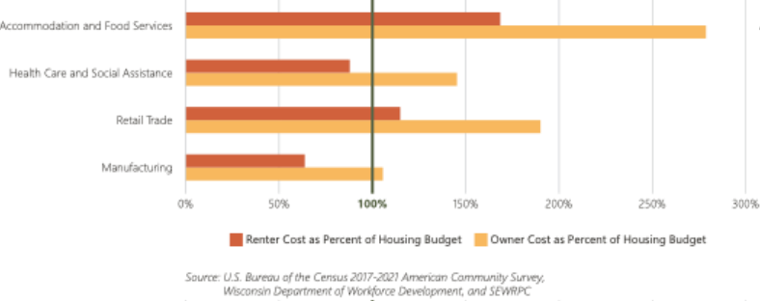
HOUSING COST IN WALWORTH COUNTY
Taken from SEWRPC publication, "Housing for a Healthy Walworth County" -2023
Notes:
Slide 1 (after Cover/Title slide)1.
(Welcome, Topics, Intro of Speakers)
Speaker’s Notes:
Derek D’Auria, Walworth County Economic Development Alliance (WCEDA) and Liz Oplatka, Gateway Technical College – Co-Hosts
Speakers
Derek D’Auria - Overview of Financial Options
Kevin Kaufman, Small Business Developoment Center (SBDC) - Whitewater – SBA Tips and Updates
Shane Griffin, Associated Bank, Elkhorn – PPP Program Tips and Updates
Derek D’Auria and Joel Espinza from WCEDA - Unemployment Tips and Updates/Other Employer Programs

Slide 5
HOUSING NEEDS IN WALWORTH COUNTY
Taken from SEWRPC publication, "Housing for a Healthy Walworth County" -2023
The standards for a healthy housing market used by the U.S. Department of Housing and Urban Development (HUD) are a homeowner vacancy rate between 1% and 2% and a rental unit vacancy rate between 4% and 6%. Delavan, Genoa City, Whitewater, and Williams Bay are short on housing for homeowners; East Troy, Fontana, Sharon, and Walworth are short on housing for *renters; and Darien, Elkhorn, and Mukwonago are short on both.
*as is the case in most university towns, renter data gets skewed. Taking out student housing, Whitewater would be short on housing for renters
Notes:
Slide 1 (after Cover/Title slide)1.
(Welcome, Topics, Intro of Speakers)
Speaker’s Notes:
Derek D’Auria, Walworth County Economic Development Alliance (WCEDA) and Liz Oplatka, Gateway Technical College – Co-Hosts
Speakers
Derek D’Auria - Overview of Financial Options
Kevin Kaufman, Small Business Developoment Center (SBDC) - Whitewater – SBA Tips and Updates
Shane Griffin, Associated Bank, Elkhorn – PPP Program Tips and Updates
Derek D’Auria and Joel Espinza from WCEDA - Unemployment Tips and Updates/Other Employer Programs

Slide 6

AVERAGE RENTS
Rates obtained from https://rentalrealestate.com/data/rent/wisconsin/
Notes:
Slide 1 (after Cover/Title slide)1.
(Welcome, Topics, Intro of Speakers)
Speaker’s Notes:
Derek D’Auria, Walworth County Economic Development Alliance (WCEDA) and Liz Oplatka, Gateway Technical College – Co-Hosts
Speakers
Derek D’Auria - Overview of Financial Options
Kevin Kaufman, Small Business Developoment Center (SBDC) - Whitewater – SBA Tips and Updates
Shane Griffin, Associated Bank, Elkhorn – PPP Program Tips and Updates
Derek D’Auria and Joel Espinza from WCEDA - Unemployment Tips and Updates/Other Employer Programs

Slide 7
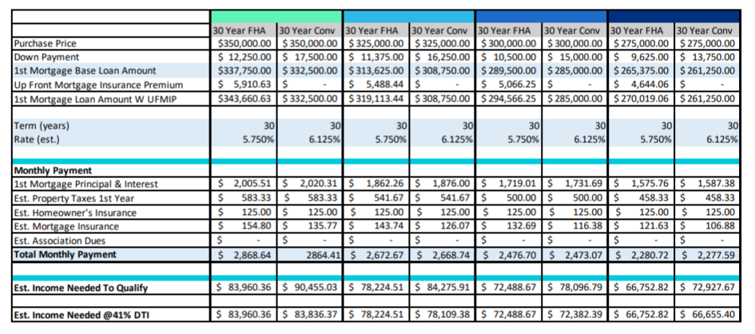
MORTGAGE ILLUSTRATION – PAGE 7 walworthbusiness.com/housing - September 2024 Report
*assumes FHA loan with 3.5% down; conventional loan with 5% down; 740 credit; rates not locked
Notes:
Slide 1 (after Cover/Title slide)1.
(Welcome, Topics, Intro of Speakers)
Speaker’s Notes:
Derek D’Auria, Walworth County Economic Development Alliance (WCEDA) and Liz Oplatka, Gateway Technical College – Co-Hosts
Speakers
Derek D’Auria - Overview of Financial Options
Kevin Kaufman, Small Business Developoment Center (SBDC) - Whitewater – SBA Tips and Updates
Shane Griffin, Associated Bank, Elkhorn – PPP Program Tips and Updates
Derek D’Auria and Joel Espinza from WCEDA - Unemployment Tips and Updates/Other Employer Programs

Slide 8
MAIN AREAS
DESIRED OUTCOMES
DELIVERABLES
Notes:
Slide 1 (after Cover/Title slide)1.
(Welcome, Topics, Intro of Speakers)
Speaker’s Notes:
Derek D’Auria, Walworth County Economic Development Alliance (WCEDA) and Liz Oplatka, Gateway Technical College – Co-Hosts
Speakers
Derek D’Auria - Overview of Financial Options
Kevin Kaufman, Small Business Developoment Center (SBDC) - Whitewater – SBA Tips and Updates
Shane Griffin, Associated Bank, Elkhorn – PPP Program Tips and Updates
Derek D’Auria and Joel Espinza from WCEDA - Unemployment Tips and Updates/Other Employer Programs

Slide 9
DESIRED OUTCOMES
ACTION
PLANNING
Notes:
Slide 1 (after Cover/Title slide)1.
(Welcome, Topics, Intro of Speakers)
Speaker’s Notes:
Derek D’Auria, Walworth County Economic Development Alliance (WCEDA) and Liz Oplatka, Gateway Technical College – Co-Hosts
Speakers
Derek D’Auria - Overview of Financial Options
Kevin Kaufman, Small Business Developoment Center (SBDC) - Whitewater – SBA Tips and Updates
Shane Griffin, Associated Bank, Elkhorn – PPP Program Tips and Updates
Derek D’Auria and Joel Espinza from WCEDA - Unemployment Tips and Updates/Other Employer Programs

Slide 10
ACTION PLANNING
4-5 MUNICIPALITIES 4-5 MUNICIPALITIES
COMMUNICATION WITH BUILDERS/DEVELOPERS
COMMUNICATION WITH COMPANIES
COMMUNICATION WITH MUNICIPALITIES
COMMUNICATION WITH MUNICIPALITIES OUTSIDE COUNTY
COMMUNICATION WITH STATE ORGANIZATIONS
COMMUNICATION WITH SURVEY/CONSULTING FIRMS
MEETINGS ATTENDED
PRESENTATION GIVEN
Notes:
Slide 1 (after Cover/Title slide)1.
(Welcome, Topics, Intro of Speakers)
Speaker’s Notes:
Derek D’Auria, Walworth County Economic Development Alliance (WCEDA) and Liz Oplatka, Gateway Technical College – Co-Hosts
Speakers
Derek D’Auria - Overview of Financial Options
Kevin Kaufman, Small Business Developoment Center (SBDC) - Whitewater – SBA Tips and Updates
Shane Griffin, Associated Bank, Elkhorn – PPP Program Tips and Updates
Derek D’Auria and Joel Espinza from WCEDA - Unemployment Tips and Updates/Other Employer Programs

Slide 11
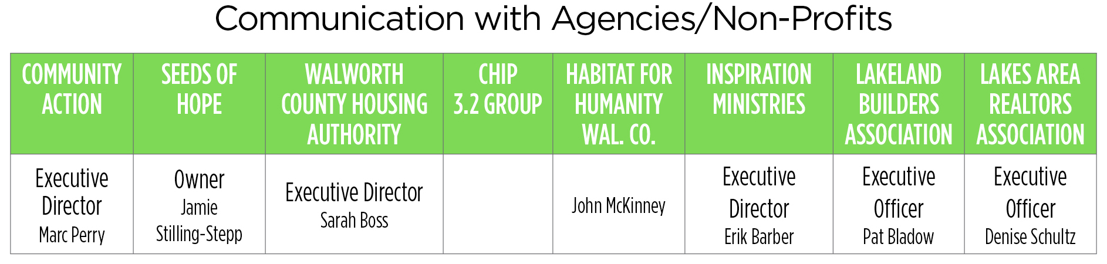
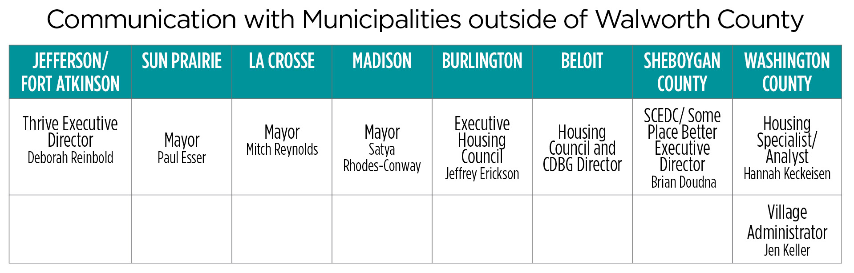
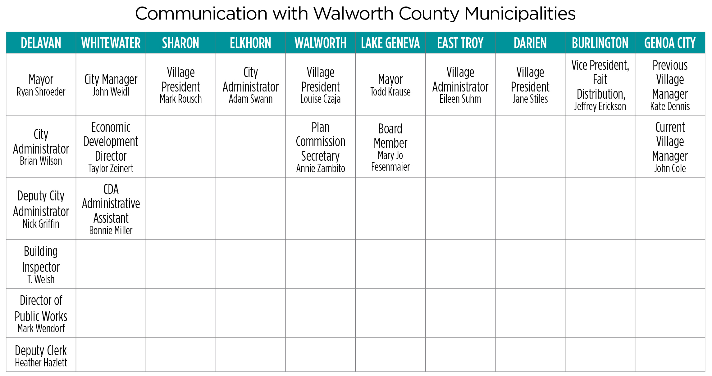
ACTIVITIES AND MEETINGS

Slide 12
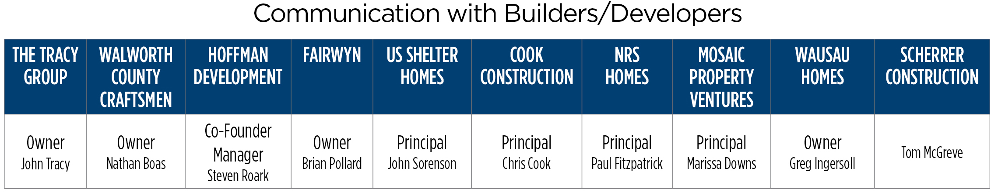

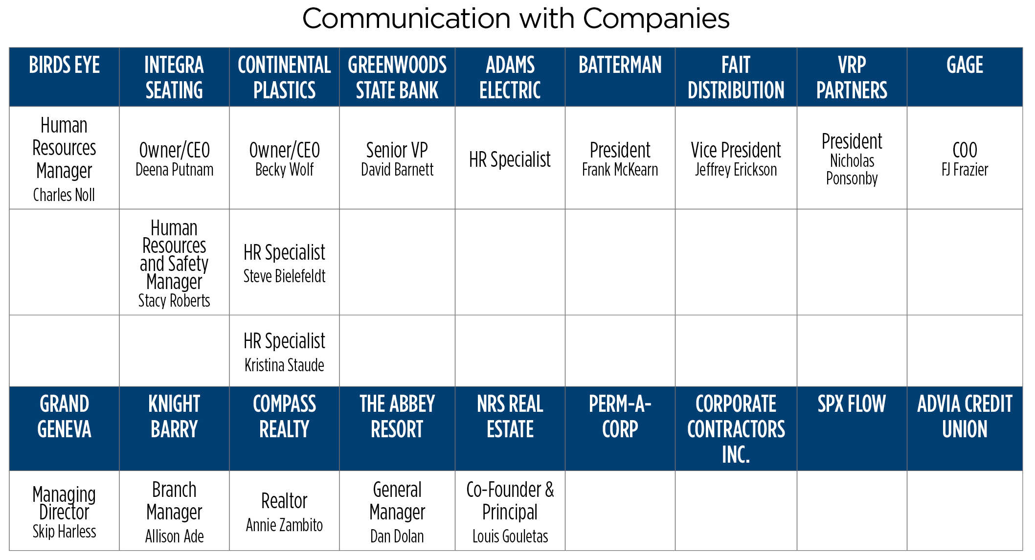
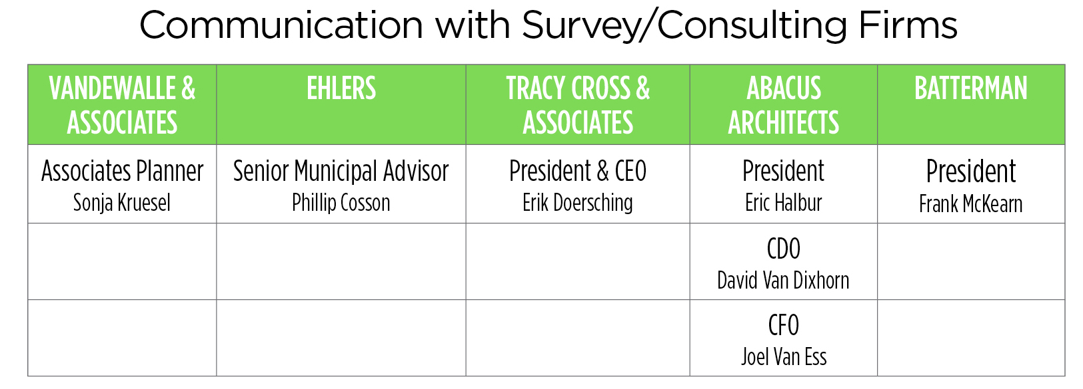
ACTIVITIES AND MEETINGS

Slide 13

ACTION
WHITEWATER
GENOA CITY
62 SF UNITS/$299K
DELAVAN
EAST TROY
ELKHORN
38 SF-A UNITS/$294K
UNDER CONSIDERATION
UNDER CONSIDERATION
UNDER CONSIDERATION
Notes:
Slide 1 (after Cover/Title slide)1.
(Welcome, Topics, Intro of Speakers)
Speaker’s Notes:
Derek D’Auria, Walworth County Economic Development Alliance (WCEDA) and Liz Oplatka, Gateway Technical College – Co-Hosts
Speakers
Derek D’Auria - Overview of Financial Options
Kevin Kaufman, Small Business Developoment Center (SBDC) - Whitewater – SBA Tips and Updates
Shane Griffin, Associated Bank, Elkhorn – PPP Program Tips and Updates
Derek D’Auria and Joel Espinza from WCEDA - Unemployment Tips and Updates/Other Employer Programs

Slide 14
ACTION – PROJECTS UNDER CONSIDERATION
DEVELOPMENT #1
DEVELOPMENT #2
DEVELOPMENT #3
100 SF, 60-80 DORM, 112 APTS, 60 APTS SP. NEEDS
80 SF - $300K, 24 SF RENTAL
106 SF Mixed, 20 DP, Senior
Notes:
Slide 1 (after Cover/Title slide)1.
(Welcome, Topics, Intro of Speakers)
Speaker’s Notes:
Derek D’Auria, Walworth County Economic Development Alliance (WCEDA) and Liz Oplatka, Gateway Technical College – Co-Hosts
Speakers
Derek D’Auria - Overview of Financial Options
Kevin Kaufman, Small Business Developoment Center (SBDC) - Whitewater – SBA Tips and Updates
Shane Griffin, Associated Bank, Elkhorn – PPP Program Tips and Updates
Derek D’Auria and Joel Espinza from WCEDA - Unemployment Tips and Updates/Other Employer Programs

Slide 15
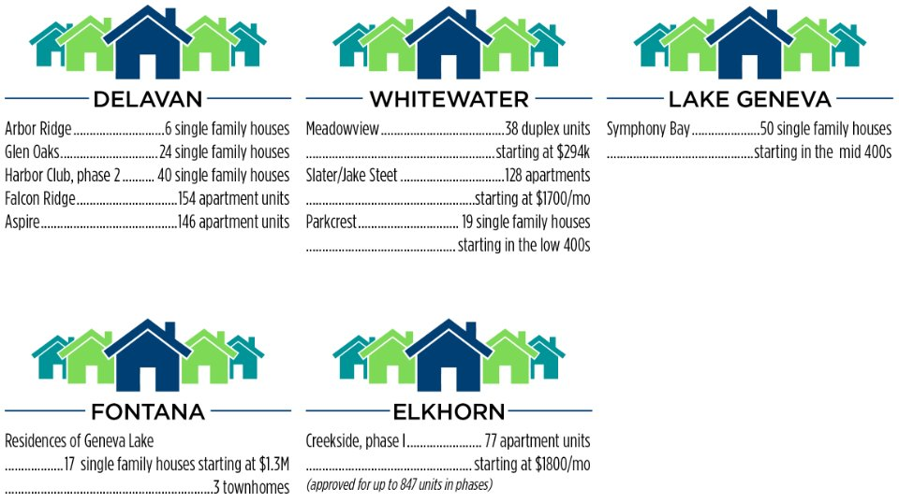
HOUSING UNDERWAY
Notes:
Slide 1 (after Cover/Title slide)1.
(Welcome, Topics, Intro of Speakers)
Speaker’s Notes:
Derek D’Auria, Walworth County Economic Development Alliance (WCEDA) and Liz Oplatka, Gateway Technical College – Co-Hosts
Speakers
Derek D’Auria - Overview of Financial Options
Kevin Kaufman, Small Business Developoment Center (SBDC) - Whitewater – SBA Tips and Updates
Shane Griffin, Associated Bank, Elkhorn – PPP Program Tips and Updates
Derek D’Auria and Joel Espinza from WCEDA - Unemployment Tips and Updates/Other Employer Programs

Slide 16
NAME OF EFFORT – NIMBY-ISM
NEXT GENERATION
NEW GENERATION
Notes:
Slide 1 (after Cover/Title slide)1.
(Welcome, Topics, Intro of Speakers)
Speaker’s Notes:
Derek D’Auria, Walworth County Economic Development Alliance (WCEDA) and Liz Oplatka, Gateway Technical College – Co-Hosts
Speakers
Derek D’Auria - Overview of Financial Options
Kevin Kaufman, Small Business Developoment Center (SBDC) - Whitewater – SBA Tips and Updates
Shane Griffin, Associated Bank, Elkhorn – PPP Program Tips and Updates
Derek D’Auria and Joel Espinza from WCEDA - Unemployment Tips and Updates/Other Employer Programs

Slide 17
HOUSING DEVELOPMENT TOOLS
ZONING
TIF
WHEDA
HOUSING FUNDS
Notes:
Slide 1 (after Cover/Title slide)1.
(Welcome, Topics, Intro of Speakers)
Speaker’s Notes:
Derek D’Auria, Walworth County Economic Development Alliance (WCEDA) and Liz Oplatka, Gateway Technical College – Co-Hosts
Speakers
Derek D’Auria - Overview of Financial Options
Kevin Kaufman, Small Business Developoment Center (SBDC) - Whitewater – SBA Tips and Updates
Shane Griffin, Associated Bank, Elkhorn – PPP Program Tips and Updates
Derek D’Auria and Joel Espinza from WCEDA - Unemployment Tips and Updates/Other Employer Programs

Slide 18
FOCUS AREAS
TIF
PARTNERSHIP MODEL
LARGER PROJECTS TIED TO COMMERCIAL/IND DEVEL.
DEVELOP MODEL BETWEEN MUNICIPALITIES & BUILDERS/DEVELOPERS
ZONING
USING ZONING OPTIONS TO REDUCE COSTS
Notes:
Slide 1 (after Cover/Title slide)1.
(Welcome, Topics, Intro of Speakers)
Speaker’s Notes:
Derek D’Auria, Walworth County Economic Development Alliance (WCEDA) and Liz Oplatka, Gateway Technical College – Co-Hosts
Speakers
Derek D’Auria - Overview of Financial Options
Kevin Kaufman, Small Business Developoment Center (SBDC) - Whitewater – SBA Tips and Updates
Shane Griffin, Associated Bank, Elkhorn – PPP Program Tips and Updates
Derek D’Auria and Joel Espinza from WCEDA - Unemployment Tips and Updates/Other Employer Programs

Slide 19
DELIVERABLES
HOUSING SUMMIT
HIRED HOUSING MGR.
WCEDA OVERSIGHT
EMPLOYER SURVEY
RESULTS STUDIES/CONSULTING
PRESENTATIONS
RECOMMENDATIONS
FUNDS SUMMARY
Notes:
Slide 1 (after Cover/Title slide)1.
(Welcome, Topics, Intro of Speakers)
Speaker’s Notes:
Derek D’Auria, Walworth County Economic Development Alliance (WCEDA) and Liz Oplatka, Gateway Technical College – Co-Hosts
Speakers
Derek D’Auria - Overview of Financial Options
Kevin Kaufman, Small Business Developoment Center (SBDC) - Whitewater – SBA Tips and Updates
Shane Griffin, Associated Bank, Elkhorn – PPP Program Tips and Updates
Derek D’Auria and Joel Espinza from WCEDA - Unemployment Tips and Updates/Other Employer Programs

Slide 20
EMPLOYER SURVEY RESULTS
EDUCATION
OPPORTUNITY
Notes:
Slide 1 (after Cover/Title slide)1.
(Welcome, Topics, Intro of Speakers)
Speaker’s Notes:
Derek D’Auria, Walworth County Economic Development Alliance (WCEDA) and Liz Oplatka, Gateway Technical College – Co-Hosts
Speakers
Derek D’Auria - Overview of Financial Options
Kevin Kaufman, Small Business Developoment Center (SBDC) - Whitewater – SBA Tips and Updates
Shane Griffin, Associated Bank, Elkhorn – PPP Program Tips and Updates
Derek D’Auria and Joel Espinza from WCEDA - Unemployment Tips and Updates/Other Employer Programs

Slide 21
MAPPING TOOL
RESIDENTIAL HOUSING OPPORTUNITY MAP – DELAVAN/EAST TROY
TASK #1 – RESIDENTIAL DEVELOPMENT OPPORTUNITY ANALYSIS
TASK # 2 – RESIDENTIAL DEVELOPMENT OPPORTUNITY MAP
TASK #3 – SUMMARY OF RESIDENTIAL DEVELOPMENT OPPORTUNITIES AND RECOMMENTATIONS
Notes:
Slide 1 (after Cover/Title slide)1.
(Welcome, Topics, Intro of Speakers)
Speaker’s Notes:
Derek D’Auria, Walworth County Economic Development Alliance (WCEDA) and Liz Oplatka, Gateway Technical College – Co-Hosts
Speakers
Derek D’Auria - Overview of Financial Options
Kevin Kaufman, Small Business Developoment Center (SBDC) - Whitewater – SBA Tips and Updates
Shane Griffin, Associated Bank, Elkhorn – PPP Program Tips and Updates
Derek D’Auria and Joel Espinza from WCEDA - Unemployment Tips and Updates/Other Employer Programs

Slide 22
GENERAL RECOMMENDATIONS
ADVISORY GROUP
LAND TRUSTS
EDUCATION CAMPAIGN
LEGISLATION
PARTNERSHIP MODEL
MODIFIED SURVEY
ZONING
REALTOR NETWORK
YOUTHBUILD PARTNERSHIP
HOUSING TYPES FOCUS
CONSULTING FUND
Notes:
Slide 1 (after Cover/Title slide)1.
(Welcome, Topics, Intro of Speakers)
Speaker’s Notes:
Derek D’Auria, Walworth County Economic Development Alliance (WCEDA) and Liz Oplatka, Gateway Technical College – Co-Hosts
Speakers
Derek D’Auria - Overview of Financial Options
Kevin Kaufman, Small Business Developoment Center (SBDC) - Whitewater – SBA Tips and Updates
Shane Griffin, Associated Bank, Elkhorn – PPP Program Tips and Updates
Derek D’Auria and Joel Espinza from WCEDA - Unemployment Tips and Updates/Other Employer Programs

Slide 23
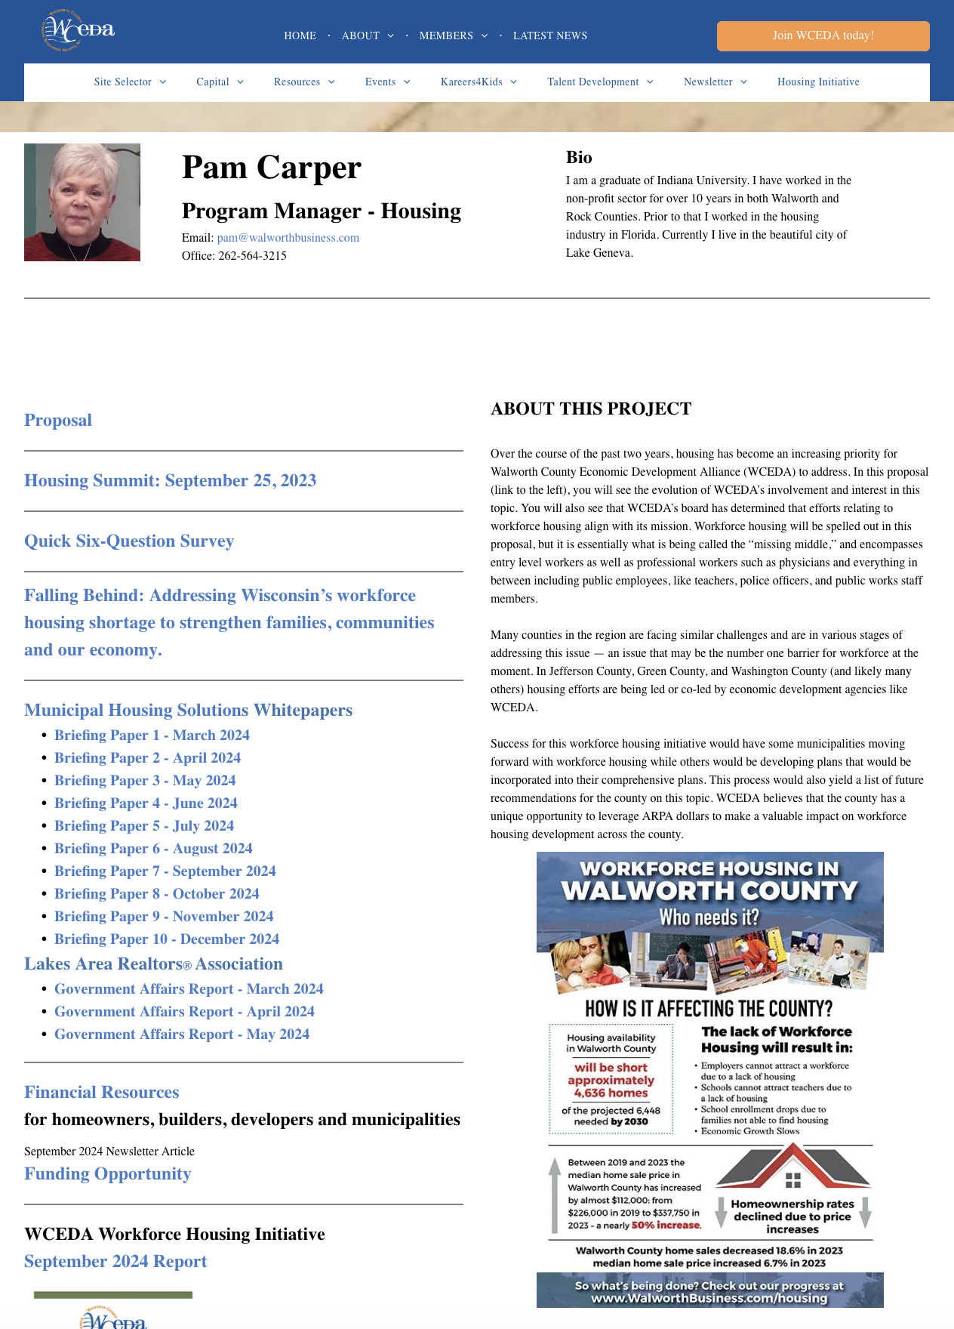
WALWORTH COUNTY HOUSING WEBPAGES walworthbusiness.com/housing
Notes:
Slide 1 (after Cover/Title slide)1.
(Welcome, Topics, Intro of Speakers)
Speaker’s Notes:
Derek D’Auria, Walworth County Economic Development Alliance (WCEDA) and Liz Oplatka, Gateway Technical College – Co-Hosts
Speakers
Derek D’Auria - Overview of Financial Options
Kevin Kaufman, Small Business Developoment Center (SBDC) - Whitewater – SBA Tips and Updates
Shane Griffin, Associated Bank, Elkhorn – PPP Program Tips and Updates
Derek D’Auria and Joel Espinza from WCEDA - Unemployment Tips and Updates/Other Employer Programs

Slide 24
Thank you!

