Slide 1


Slide 2
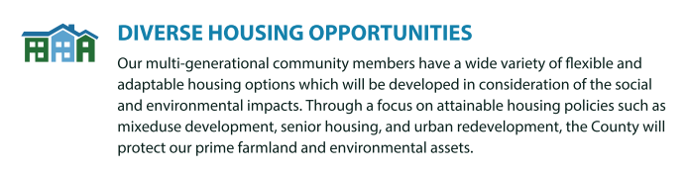
HOUSING IN GREATER JEFFERSON COUNTY
Challenges
Limited inventory
Mismatch between housing stock and demographics and needs
Aging housing stock and insufficient new construction
Current efforts
Housing is included as one of four priorities in Jefferson County’s 2023-2033 Strategic Plan

Slide 3

-Increase affordable housing for families
-Increase communication without a “newspaper”
-Support thriving businesses and grow the tax base
-Improve the City’s recruitment, retention, and diversity
-Align future expenditures with available resources

Slide 4
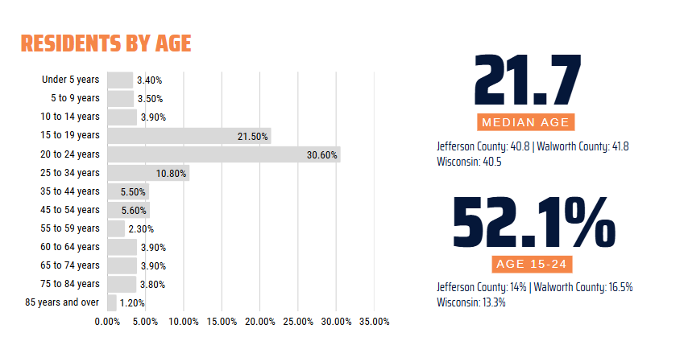
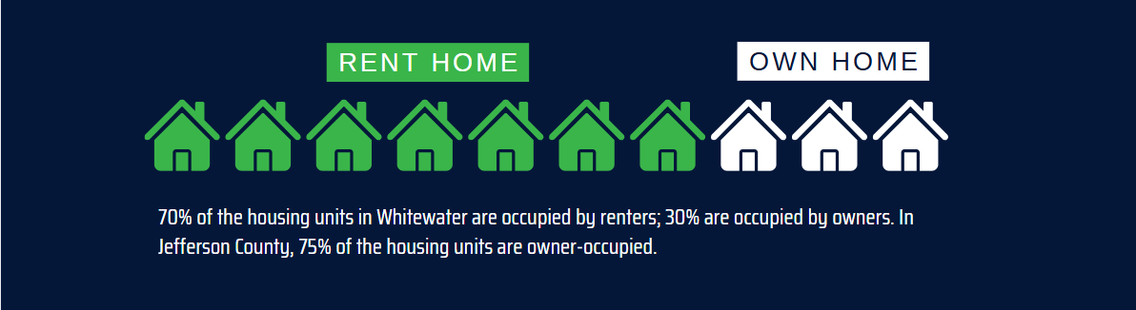
SETTING THE STAGE: HOUSING AND DEMOGRAPHICS IN WHITEWATER

Slide 5
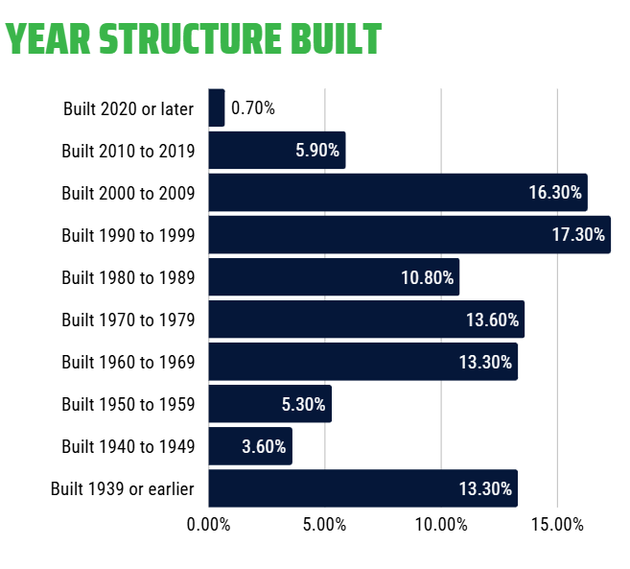
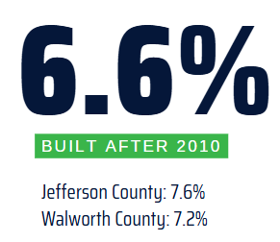
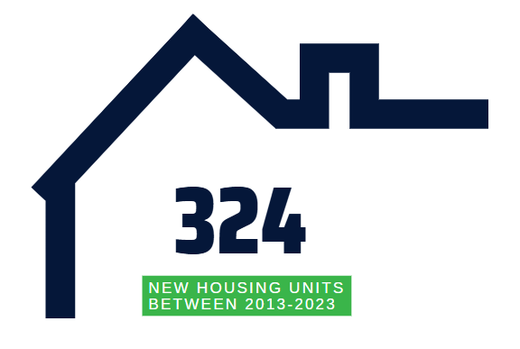
SETTING THE STAGE: HOUSING AND DEMOGRAPHICS IN WHITEWATER

Slide 6
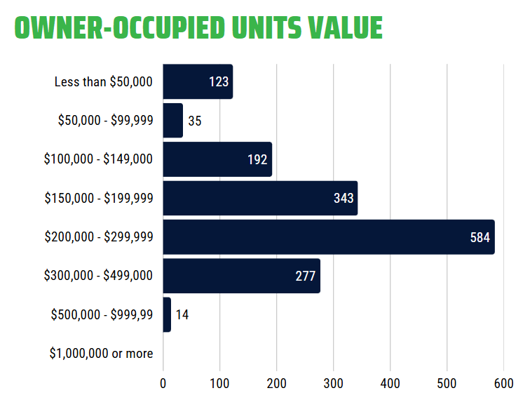
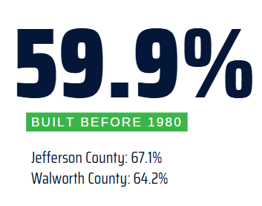
SETTING THE STAGE: HOUSING AND DEMOGRAPHICS IN WHITEWATER

Slide 7
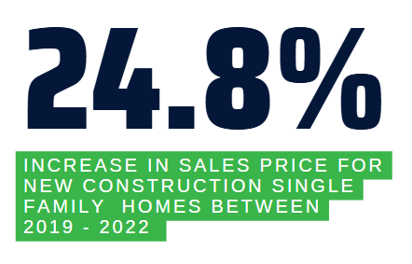
RISING COSTS
Construction costs require rental rates and mortgages that are out of reach for workforce, families, etc.
Source: Cost of Constructing a Home -2024,
National Association of Home Builders
Source: Census Bureau’s Survey of Construction (SOC)

Slide 8
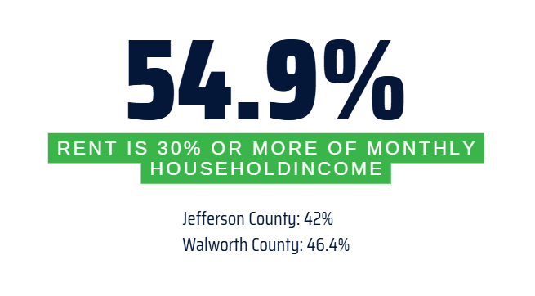
COST BURDENED RENTERS
Households need to make at least $50,000 per year to not be cost burdened by a monthly rent of $1,250.
According to the 2023 census, 50% of all Whitewater households make less than $50,000.
Notes:
Approx cost to construct new MF units = $243,000
Need to make $50,000 / yr as a household to afford to pay $1,250 / mo in rent. Equivalent of $24.00/hr. Currently 50% of households in Whitewater make less than $50,000 / yr.
Household definition: Includes related family members and unrelated people who share the housing unit.
A housing unit is defined as a house, apartment, group of rooms, or a single room intended for occupancy as separate living quarters. Housing units exclude group quarters such as dormitories and transient accommodations such as hotels. Units in assisted living facilities are considered to be housing units, however, units in nursing homes are not considered to be housing units.

Slide 9
INCENTIVIZING DEVELOPMENT
LIVE LOCAL DEVELOPMENT FUND (LLDF) offers below market interest rates to incent developers to build in Greater Jefferson County.
TIF is a financing tool that captures the future increase in property tax revenue resulting from new development to fund current infrastructure and development projects
Enables communities to revitalize underdeveloped areas without impacting existing taxpayers

Slide 10
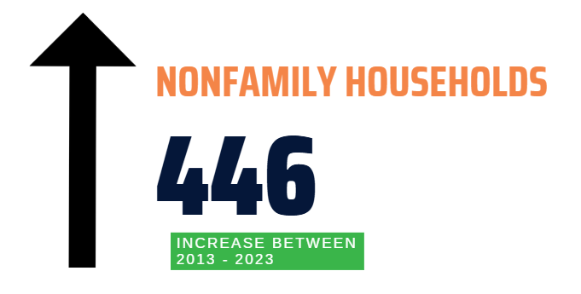
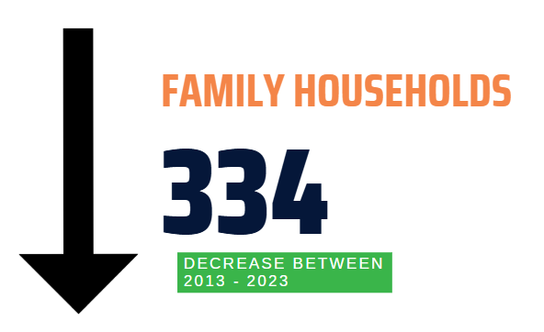
WHERE ARE THE GAPS?
High turnover rates in student housing destabilize the rental market and create challenges for property management and upkeep. High turnover rates can also create transient neighborhoods with little long-term community investment. This leaves gaps in the market for higher-quality units that appeal to professionals or families.
Notes:
Housing unit statistics exclude group quarters such as dormitories and rooming houses, transient accommodations such as hotels. Units in assisted living facilities are considered to be housing units, however, units in nursing homes are not considered to be housing units.
Over 5,000 people are traveling into Whitewater to work.

Slide 11
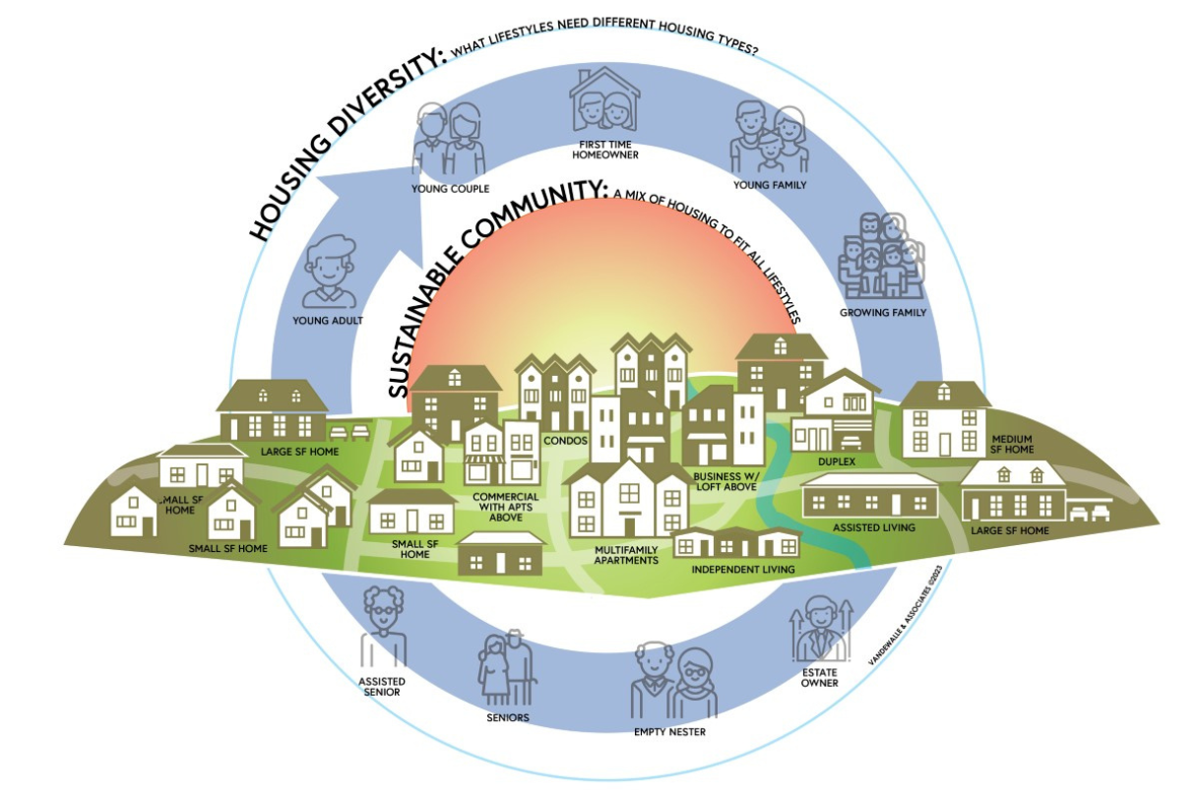
WHY HOUSING IS A PRIORITY
A growing population and workforce depend on diverse housing options
Without adequate housing, community/county risks losing talent and economic potential

Slide 12
-Increase affordable housing for families
-Increase communication without a “newspaper”
-Support thriving businesses and grow the tax base
-Improve the City’s recruitment, retention, and diversity
-Align future expenditures with available resources

